Slide 1
Security and Personnel

Slide 2
Agenda
Introduction
Positioning and Staffing the Security Function
Credentials of Information Security Professionals
Employment Policies and Practices

Slide 3
Introduction
When implementing information security, there are many human resource issues that must be addressed
Positioning and naming Staffing
Evaluating impact of information security across every role in IT function
Integrating solid information security concepts into personnel practices
Employees often feel threatened when the information security program is being updated

Slide 4
Positioning and Staffing the Security Function
The information security function can be placed within:
IT function
Physical security function Administrative services function Insurance and risk management function Legal department
Organizations balance needs of enforcement with needs for education, training, awareness, and customer service

Slide 5
Staffing the Information Security Function
Selecting personnel is based on many criteria, including supply and demand
Many professionals enter security market by gaining skills, experience, and credentials
At present, information security industry is in a period of high demand

Slide 6
Staffing the Information Security Function
Qualifications and Requirements
The following factors must be addressed:
General management should learn more about position requirements and qualifications for both IS and IT positions
Upper management should learn more about budgetary needs of information security function
IT and general management must learn more about level of influence and prestige the information security function should be given in order to be effective.
Organizations typically look for technically qualified information security generalist

Slide 7
Staffing the Information Security Function
Entry into the Information Security Profession
Many information security professionals enter the field through one of two career paths:
Law enforcement and military
Technical, working on security applications and processes

Slide 8
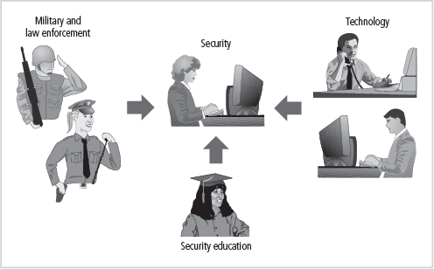
Staffing the Information Security Function
Figure 11-1 Career Paths to Information Security Positions

Slide 9
Staffing the Information Security Function
Entry into the Information Security Profession
Many information security professionals enter the field through one of two career paths:
Law enforcement and military
Technical, working on security applications and processes
In recent years, college students select and tailor degree programs to prepare for work in information security
Organizations can foster greater professionalism in the information security discipline by establishing clearly defined expectations and position descriptions

Slide 10
Staffing the Information Security Function
Information Security Positions
The use of standard job descriptions can increase the degree of professionalism in the information security field as well as improve the consistency of roles and responsibilities among organizations
Charles Cresson Wood’s book Information Security Roles and Responsibilities Made Easy offers set of model job descriptions

Slide 11
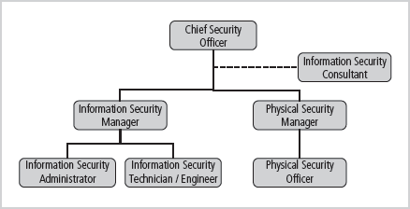
Staffing the Information Security Function
Figure 11-2 Positions in Information Security

Slide 12
Staffing the Information Security Function
Security Manager
Accountable for day-to-day operation of information security program
Accomplish objectives as identified by CISO
Typical qualifications: not uncommon to have accreditation; ability to draft middle and lower-level policies; standards and guidelines; budgeting, project management, and hiring and firing; manage technicians

Slide 13
Staffing the Information Security Function
Security Technician
Technically qualified individuals tasked to configure security hardware and software
Tend to be specialized Typical qualifications:
Varied; organizations prefer expert, certified, proficient technician
Some experience with a particular hardware and software package
Actual experience in using a technology usually required

Slide 14
Credentials of Information Security Professionals
Certification Costs
Better certifications can be very expensive
Even experienced professionals find it difficult to take an exam without some preparation
Many candidates teach themselves through trade press books; others prefer structure of formal training
Before attempting a certification exam, do all homework and review exam criteria, its purpose, and requirements in order to ensure that the time and energy spent pursuing certification are well spent.

Slide 15
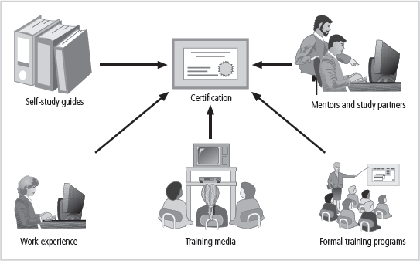
Credentials of Information Security Professionals
Figure 11-3 Preparing for Security Certification

Slide 16
Employment Policies and Practices
The general management community of interest should integrate solid information security concepts into the organization’s employment policies and practices
Organization should make IS a documented part of every employee’s job description
From information security perspective, hiring of employees is a responsibility laden with potential security pitfalls
CISO and information security manager should provide human resources with information security input to personnel hiring guidelines

Slide 17
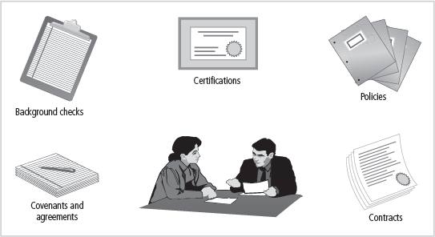
Employment Policies and Practices
Figure 11-4 Hiring Issues

Slide 18
Job Descriptions
Integrating information security perspectives into hiring process begins with reviewing and updating all job descriptions
Organization should avoid revealing access privileges to prospective employees when advertising open positions

Slide 19
Interviews
An opening within the information security department creates a unique opportunity for the security manager to educate human resource (HR) on certifications, experience, and qualifications of a good candidate
Information security should advise HR to limit information provided to the candidate on the responsibilities and access rights the new hire would have
For organizations that include on-site visits as part of interviews, it is important to use caution when showing candidate around facility

Slide 20
Interviews
An opening within the information security department creates a unique opportunity for the security manager to educate human resource (HR) on certifications, experience, and qualifications of a good candidate
Information security should advise HR to limit information provided to the candidate on the responsibilities and access rights the new hire would have
For organizations that include on-site visits as part of interviews, it is important to use caution when showing candidate around facility

Slide 21
Background Checks
Investigation into a candidate’s past
Should be conducted before organization extends offer to candidate
Background checks differ in level of detail and depth with which candidate is examined
May include identity check, education and credential check, previous employment verification, references check, workers compensation history, motor vehicle records, drug history, credit history, and more

Slide 22
Types of Background Checks
Identity checks: Validation of identity and Social Security number
Education and credential checks: Validation of institutions attended, degrees and certifications earned, and certification status
Previous employment verification: Validation of where candidates worked, why they left, what they did, and for how long
Reference checks: Validation of references and integrity of reference sources

Slide 23
Types of Background Checks
Worker’s compensation history: Investigation of claims from worker’s compensation
Motor vehicle records: Investigation of driving records, suspensions, and DUIs
Drug history: Screening for drugs and drug usage, past and present
Credit history: Investigation of credit problems, financial problems, and bankruptcy
Civil court history: Investigation of involvement as the plaintiff or defendant in civil suits
Criminal court history: Investigation of criminal background, arrests, convictions, and time served

Slide 24
Employment Policies and Practices
Employment Contracts
Once a candidate has accepted the job offer, employment contract becomes important security instrument
Many security policies require an employee to agree in writing
New employees may find policies classified as employment contingent upon agreement, whereby employee is not offered the position unless binding organizational policies are agreed to

Slide 25
Employment Policies and Practices
New employees should receive extensive information security briefing on policies, procedures, and requirements for IS
Levels of authorized access are outlined; training provided on secure use of information systems
By the time employees start, they should be thoroughly briefed and ready to perform duties securely

Slide 26
New Hire Orientation
New employees should receive extensive information security briefing on policies, procedures, and requirements for IS
Levels of authorized access are outlined; training provided on secure use of information systems
By the time employees start, they should be thoroughly briefed and ready to perform duties securely

Slide 27
On-the-Job Security Training
Organization should conduct periodic security awareness training
Keeping security at the forefront of employees’ minds and minimizing employee mistakes is an important part of information security awareness mission
External and internal seminars also increase level of security awareness for all employees, particularly security employees

Slide 28
Evaluating Performance
Organizations should incorporate IS components into employee performance evaluations
Employees pay close attention to job performance evaluations
If evaluations include information security tasks, employees are more motivated to perform these tasks at a satisfactory level

Slide 29
Termination
When employee leaves organization, there are a number of security-related issues
Key is protection of all information to which employee had access
Once cleared, the former employee should be escorted from premises
Many organizations use an exit interview to remind former employee of contractual obligations and to obtain feedback

